Slide 1
This is how we do it
Phonics
September 2019

Slide 2
What is it? Why do we teach it?
I cnduo't bvleiee taht I culod aulaclty uesdtannrd waht I was rdnaieg. Unisg the icndeblire pweor of the hmuan mnid, aocdcrnig to rseecrah at Cmabrigde Uinervtisy, it dseno't mttaer in waht oderr the lterets in a wrod are, the olny irpoamtnt tihng is taht the frsit and lsat ltteer be in the rhgit pclae. The rset can be a taotl mses and you can sitll raed it whoutit a pboerlm. Tihs is bucseae the huamn mnid deos not raed ervey ltteer by istlef, but the wrod as a wlohe. Aaznmig, huh? Yaeh and I awlyas tghhuot slelinpg was ipmorantt! See if yuor fdreins can raed tihs too.

Slide 3
Sorry, it’s not quite that simple!
Combination of knowledge and skills.
Assimilated very quickly.
Used for reading and writing.
Reversible processses.

Slide 4
Phonological Awareness
General sound discrimination - environmental
Awareness of the sounds around them and to develop their listening skills. Suggested activities - listening walk, drumming on different items outside and comparing the sounds, playing a sounds lotto game and making shakers.
General sound discrimination - instrumental sounds
Awareness of sounds made by various instruments and noise makers. Activities include comparing and matching sound makers, playing instruments alongside a story and making loud and quiet sounds.
General sound discrimination - body percussion
Develop children's awareness of sounds and rhythms. Activities include singing songs and action rhymes, listening to music and developing a sounds vocabulary.
Rhythm and rhyme
Develop children's appreciation and experiences of rhythm and rhyme in speech. Activities include rhyming stories, rhyming bingo, clapping out the syllables in words and odd one out.

Slide 5
Phonological Awareness
Rhythm and rhyme
Develop children's appreciation and experiences of rhythm and rhyme in speech. Activities include rhyming stories, rhyming bingo, clapping out the syllables in words and odd one out.
Alliteration
The focus is on initial sounds of words, with activities including I-Spy type games and matching objects which begin with the same sound.
Voice sounds
Distinguish between different vocal sounds and to begin oral blending and segmenting. Activities include Metal Mike, where children feed pictures of objects into a toy robot's mouth and the teacher sounds out the name of the object in a robot voice - /c/-/u/-/p/ cup, with the children joining in.

Slide 6
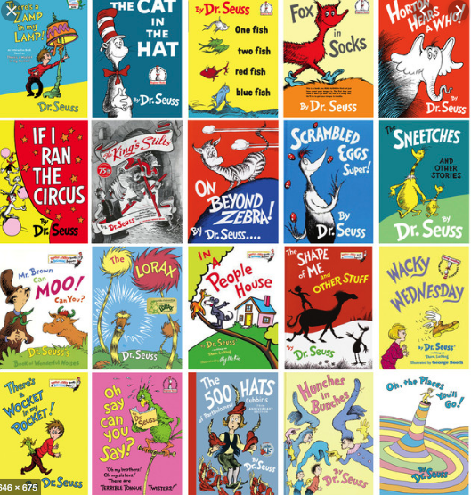

Slide 7
Oral blending and segmenting
Oral blending and segmenting
To develop oral blending and segmenting skills.
To practise oral blending, you say some sounds, such as /c/-/u/-/p/ and see whether your child can pick out a cup from a group of objects. (You could hold up an object such as a sock and ask the them which sounds they can hear in the word sock.)
These activities are intended to continue as lots of practice is needed before children will become confident in their phonic knowledge and skills.

Slide 8
Fred Talk/Toy Talk/Robot Talk
cat hen pin lot hut
help head bread thin think
long pond just jump crust
Phoneme – a sound
Grapheme – a squiggle that represents a phoneme

Slide 9
Fred Talk/Toy Talk/Robot Talk
cat hen pin lot hut
help head bread thin think
long pond just jump crust
Remember – segment and blend!
How many phonemes? How many graphemes?

Slide 10
Grapheme-Phoneme Correspondence

Slide 11
Talk Tidy

Slide 12
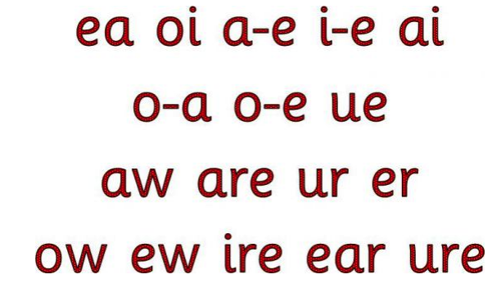
Speed Sounds - Sets
Special Friends – one sound, more than one letter (still one grapheme!)

Slide 13
Phoneme Frames

Slide 14
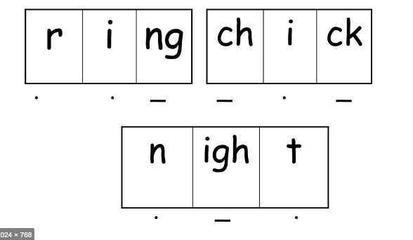
Sound Buttons – Dots and Dashes

Slide 15
Reversible Processes
Grapheme-Phoneme Correspondence (reading)
Phoneme-Grapheme Correspondence (writing)

Slide 16
Green Words

Slide 17
Green Words

Slide 18
Green Words

Slide 19
Green Words

Slide 20
Red Words

Slide 21
Multi-sensory
Co-ordination
Fine motor control
Memory
Positional language

Slide 22
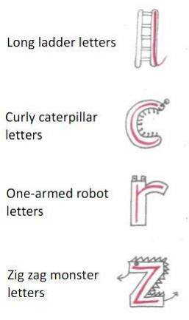
Letter Formation Families
Long ladder: i, u, y, l, t, j
Curly caterpillar: c, o, a, g, d, q, e, s, f
One armed robot: r, n, m, h, b, p, k
Zig Zag: v, w, x, z

Slide 23
Phoneme
Encoding
The smallest unit of sound in a word.
Identifying the individual phonemes in a spoken word and writing them down to form a word.
Oral blending
Digraph
Hearing a series of spoken phonemes and merging them together to make a spoken word without corresponding to any graphemes (no text is needed). E.g. teacher ays ‘b-u-s’ children say ‘bus’.
Two letters that make one phoneme e.g. duck

Slide 24
Decoding
Grapheme
How a phoneme is spelled. Each grapheme is a unit of sound regardless of how many letters there are.
The process of decoding a word has two stages. Firstly the individual grapheme-phoneme correspondence is recognised and then the phonemes are blended or synthesised into the word as it is read.
A digraph in which the two letters are not adjacent e.g.
make.
Split digraph
Consonant Cluster/
Consonant Blend
Blending
Recognising the letter sounds in a written word and merging them together in the order they are written in to pronounce the word, e.g. c-u-p = cup
This is not a digraph but two phonemes clustered together e.g. br tr fl pl shr sp
.

